Slide 1

BANGLADESH ARMY UNIVERSITY OF SCIENCE AND TECHNOLOGY, BAUST
Smart Home Dashboard
Software Development Project II
Course Code: CSE3100
Submitted By:
Submitted To:
Md. Rokunujaman Sarker
ID: 0802320205101045
Munira Akter Mou
(Lecturer)
Maskur Al Shal Sabil
(Lecturer)

Slide 2
Project Overview
A comprehensive IoT solution combining mobile and hardware technologies
Android mobile application for remote device control
ESP32 microcontroller firmware for hardware integration
Real-time synchronization using Firebase Realtime Database
Control lights, fans, and smart plugs from anywhere
Support for both app-based and physical switch control

Slide 3
Purpose & Goals
Purpose: Create an accessible smart home automation system
Enable remote monitoring and control of home devices
Provide seamless integration between mobile and hardware
Goals: User-friendly interface with Material Design
Real-time bidirectional synchronization
Reliable ESP32-Firebase-Android communication
Multi-room device organization
Secure user authentication and data management

Slide 4
Key Features - Android App
User Authentication: Email/Password, Google Sign-In, Firebase Auth
Dashboard: Room-based UI, main power switch, profile management
Device Control: Toggle devices, real-time updates, modern UI
Firebase Settings: Configure connection, diagnostics
Background Sync: Automatic synchronization

Slide 5
Key Features - ESP32 Hardware
4-Channel Relay Control: Multiple relay types, safe GPIO setup
Physical Switch Support: Manual override, debounce, sync
Firebase Integration: Realtime streaming, reconnection
WiFi Management: Auto-reconnect, diagnostics

Slide 6
Technologies Used
Android: Java 17, SDK 24–34, Firebase, Material Design 3
ESP32:Firebase-ESP Client, WiFi, relay module
Tools: Android Studio, Arduino IDE, Firebase Console

Slide 7
Main Application Components
Dashboard Activity: Rooms, master switch, profile
Room Activity: Device management, real-time status
ESP32 Settings Activity: configure IP, test connection

Slide 8
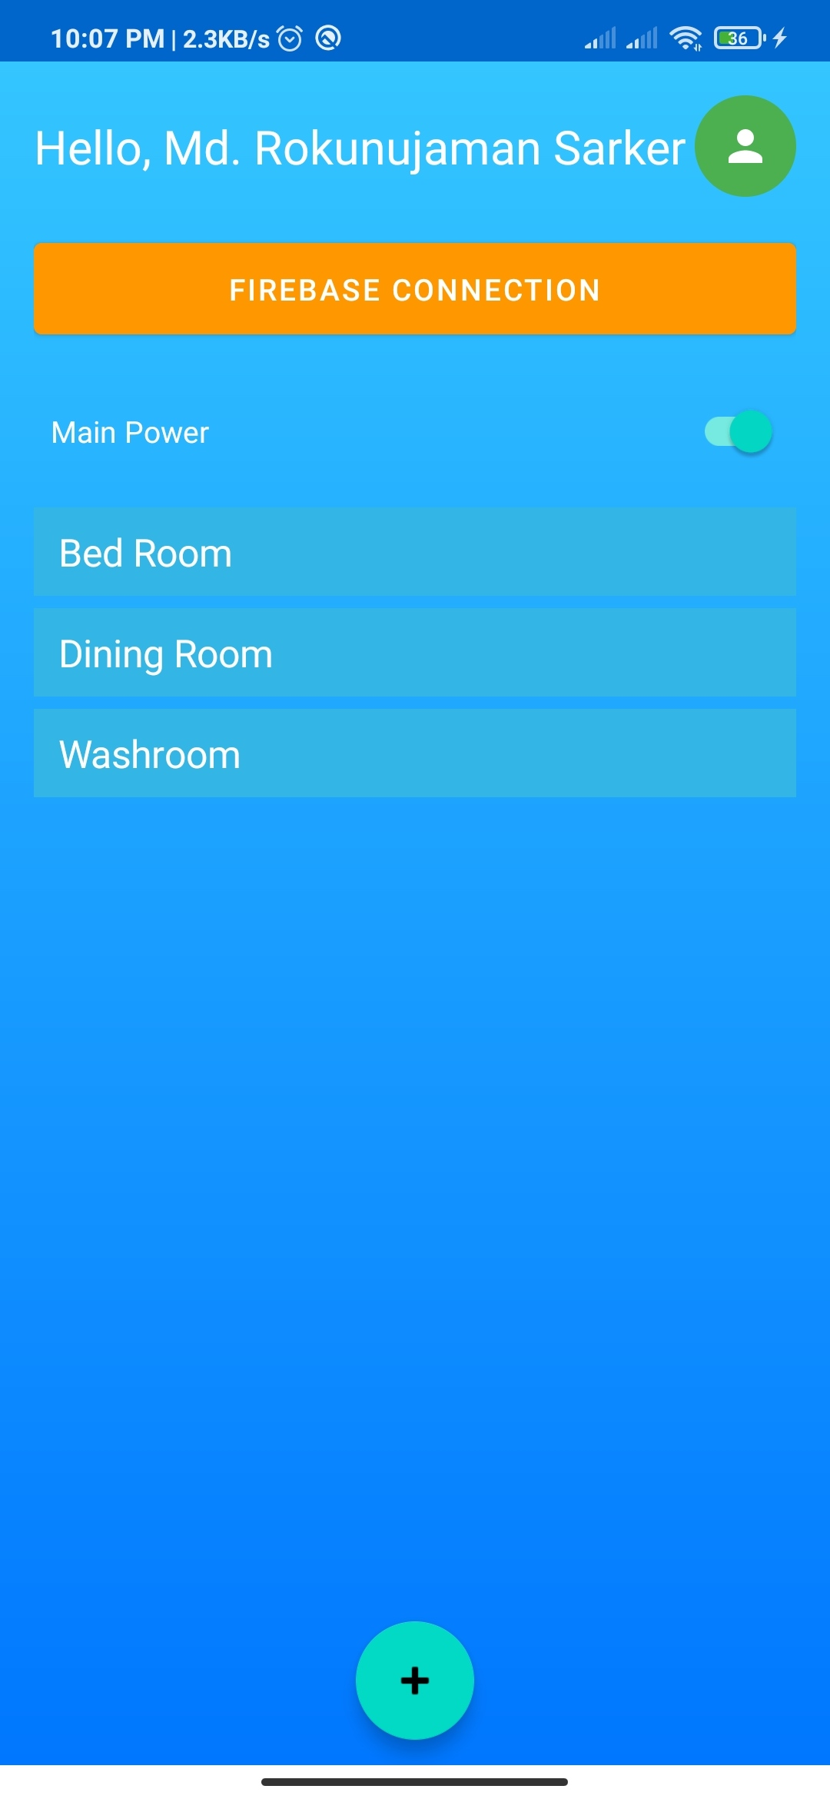
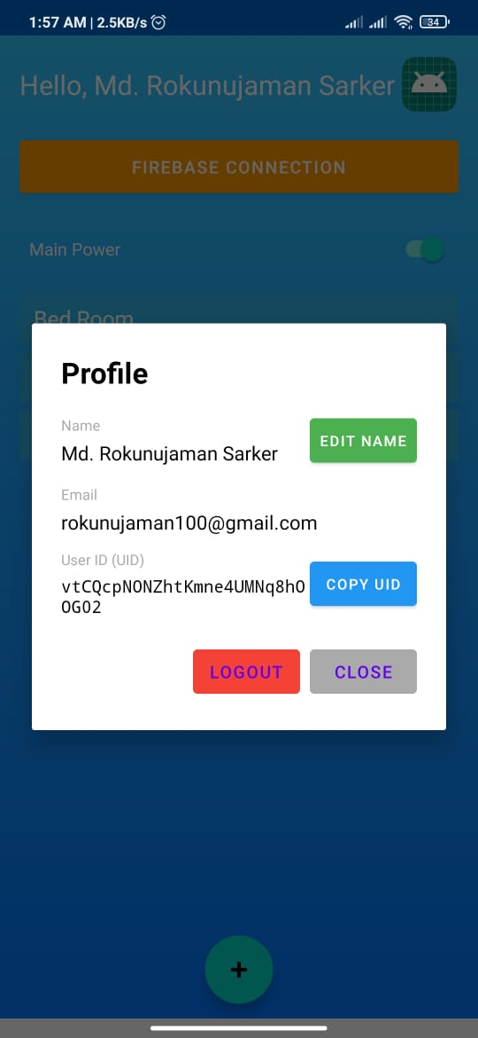
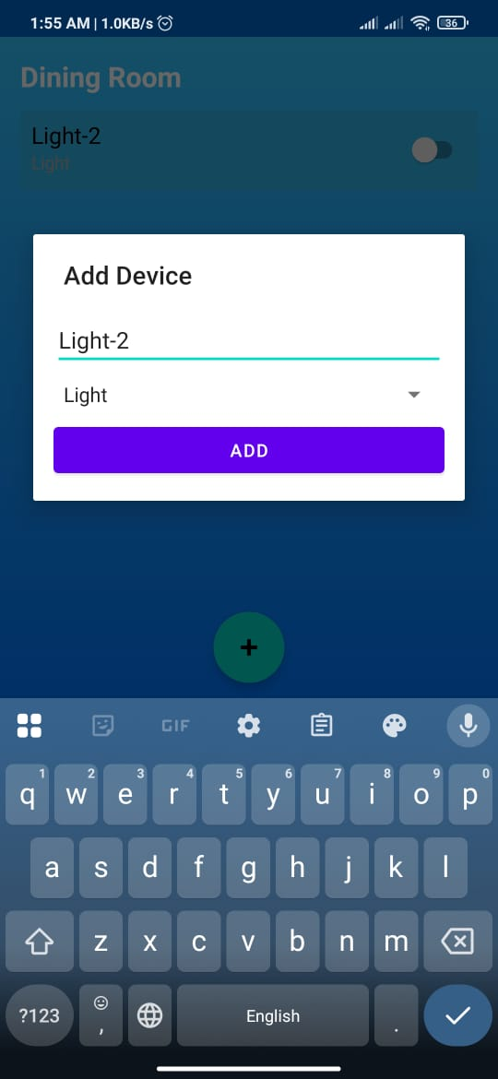
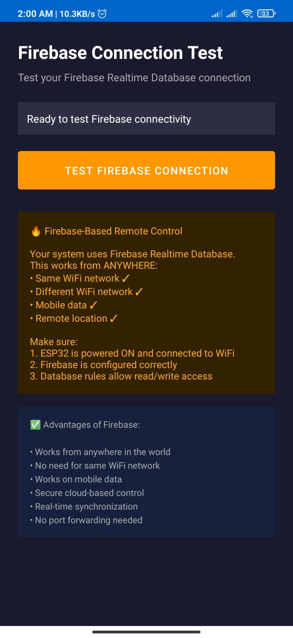
System Architecture
Dashboard Activity
Profile Activity
Room Activity
Firebase Settings

Slide 9
Benefits & Advantages
Convenience: Remote control anywhere
Flexibility: Remote + manual control, multi-user
Organization: Room-based structure
Reliability: Realtime sync, auto-reconnect

Slide 10
Future Enhancements
Voice assistant support
Scheduling & automation rules
Energy monitoring
Multi-home support
Widgets, dark mode
Push notifications
Analytics dashboard

Slide 11
Thank You
for your attention

